Slide 1
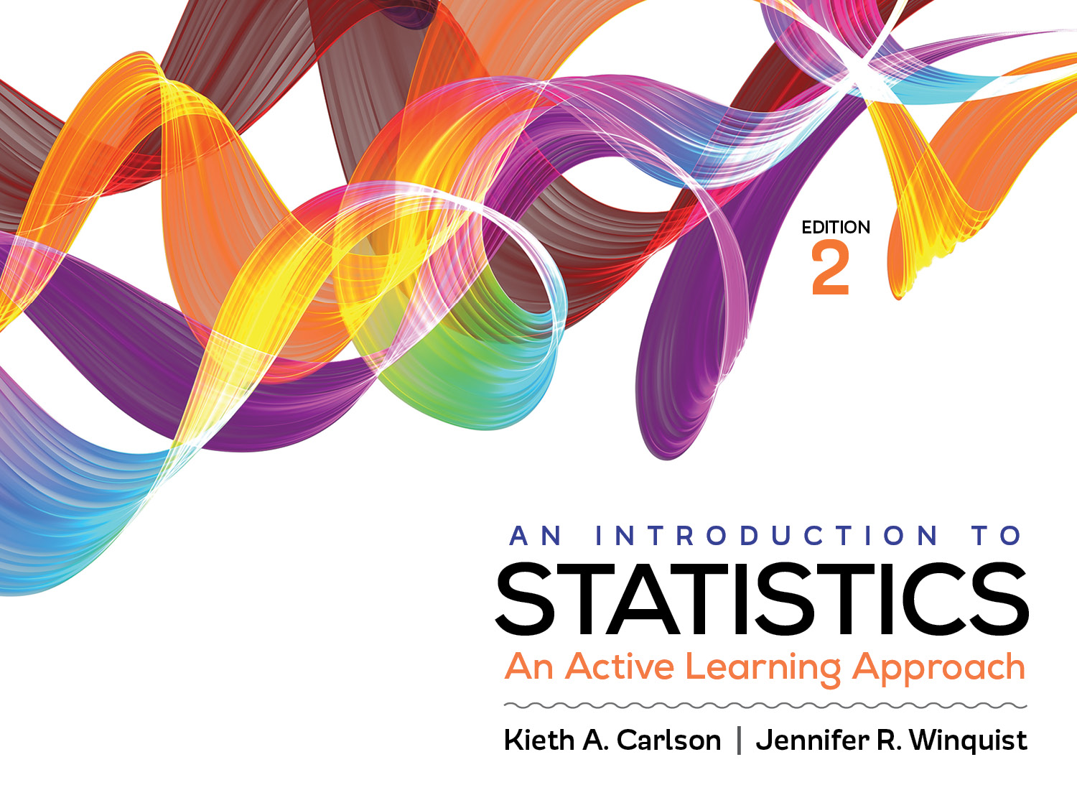
Introduction to Activity 13.4
Regression

Slide 2
Activity 13.4 will require you to:
Compute a regression equation by hand and SPSS
Use that equation to predict an unknown value
Summarize the results in APA style

Slide 3
Logic of regression
If two variables have a strong relationship (i.e., a strong r), you can use that relationship to predict one value from another
Height and weight are highly correlated so if I know someone’s height I can use the correlation to predict their weight
The predict will have some prediction error (similar to sampling error)
The stronger the relationship the more accurate the prediction will be.

Slide 4
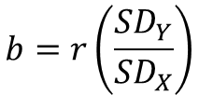


Regression equation
Y is the variable you are trying to predict
X is the variable you know the value of
b and a are values computed from the data
b is called the slope; it reflects how my the value of Y changes with each unit change in X
a is called the Y-intercept; it reflects the value of Y when X = 0
$$Y=bX+a$$
$$b=r\left(\frac{{SD}_{Y}}{{SD}_{X}}\right)$$
$$a= M_{Y}−bM_{X}$$

Slide 5
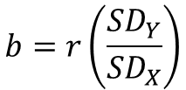


Regression equation
This is the regression equation
First, find the specific values of b and a.
Then, substitute a value of X into the equation to predict the most likely Y value.
You should recognize that there will be error in your prediction. This is the most likely Y value; the actual Y value is expected to be “close” to the predicted Y value.
Stronger correlations (rs) make more accurate predictions
$$Y=bX+a$$
$$b=r\left(\frac{{SD}_{Y}}{{SD}_{X}}\right)$$
$$a= M_{Y}−bM_{X}$$

